Slide 1

ANALYSIS ON MOST RUNS SCORED IN INTERNATIONAL CRICKET
AKASH.S (21BCE1705)
SRICHARAN ADAPA (21BCE6072)

Slide 2
Table creation:
Rcode
Sl_no=c(1,2,3,4,5,6,7,8,9,10,11,12,13,14,15,16,17,18,19,20)
name=c("Sachin Tendulkar","Kumar Sangakkara","Ricky Ponting","Mahela Jayawardene",
"Rahul Dravid","Virat Kohli","Brain Lara","AB de Villiers","Chris Gayle","Younis Khan",
"Joe Root", "MS Dhoni","Shahid Afridi","David Warner","Kane Williamson","Adam Gilchrist",
"Shoaib Malik","Babar Azam","Michael Hussey","Kevin Pietersen" )
nationality=c(0,1,2,1,0,0,3,4,3,5,6,0,5,2,7,2,5,5,2,6)
innings=c(782,666,668,725,605,527,521,484,551,491,405,526,508,407,381,429,429,252,324,342)
runs=c(34357,28016,27483,25957,24208,24130,22358,20014,19593,
17790,17604,17266,11196,16466,15889,15461,11867,11017,12398,13797)
average=c(48.52,46.77,45.95,39.15,45.41,53.62,46.28,48.11,37.97,39.88,49.03,44.96,23.92,43.10,46.45,38.94,33.90,50.53,49.00,44.07)

Slide 3
S_rate=c(67.58,66.56,68.48,64.73,51.98,79.15,68.08,74.71,77.22,60.57,65.73,79.07,114.14,86.32,66.30,91.43,77.60,81.49,64.54,71.80)
Bat=data.frame(Sl_no,name,nationality,innings,runs,average,S_rate)
Bat
Bat$nationality=factor(Bat$nationality,labels=c("India","Sri Lanka","Australia","West Indies","South Africa","Pakistan","England","New Zealand"))

Slide 4
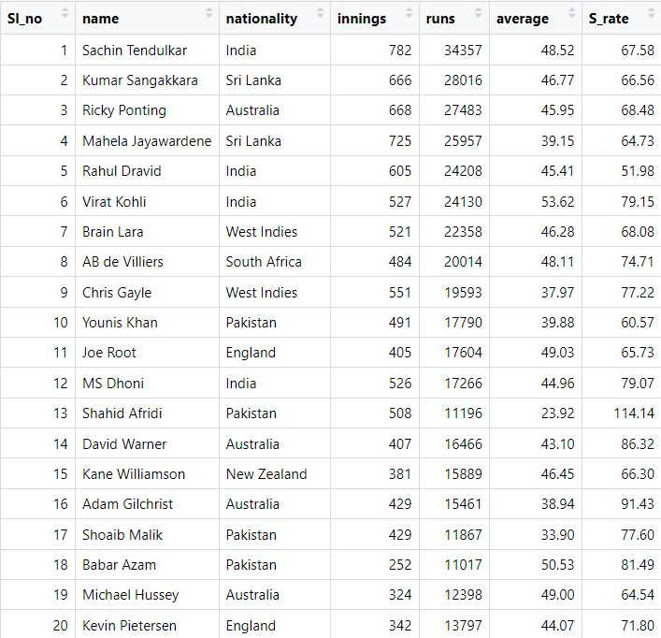
OUTPUT:

Slide 5
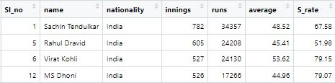
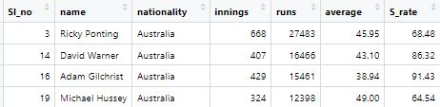
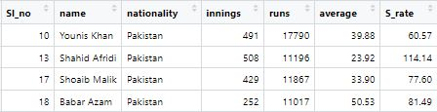
Tables based on nationality
India
Rcode:
Team_Ind=subset(Bat,Bat$nationality=='India')
Output:
Australia
Rcode:
Team_Aus=subset(Bat,Bat$nationality=='Australia')
Output:
Pakistan
Rcode:
Team_PAK=subset(Bat,Bat$nationality=='Pakistan')
Output:
Rcode for the rest of the teams:
Team_SL=subset(Bat,Bat$nationality=='Sri Lanka')
Team_NZ=subset(Bat,Bat$nationality=='New Zealand')
Team_WI=subset(Bat,Bat$nationality=='West Indies')
Team_RSA=subset(Bat,Bat$nationality=='South Africa')
Team_Eng=subset(Bat,Bat$nationality=='England')

Slide 6



Measures of central tendency for runs of each team
India
Rcode:
summary(Team_Ind$runs)
Australia
Rcode:
summary(Team_Aus$runs)
Pakistan
Rcode:
summary(Team_PAK$runs)
Rcode for the remaining teams:
summary(Team_SL$runs)
summary(Team_NZ$runs)
summary(Team_WI$runs)
summary(Team_RSA$runs)
summary(Team_Eng$runs)

Slide 7
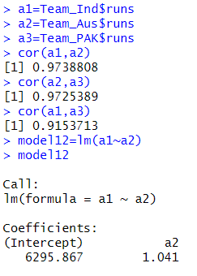
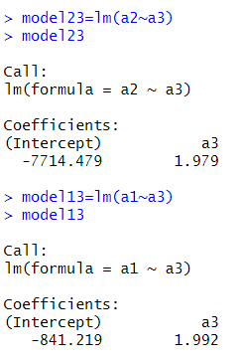
Correlation between the teams:
Between India and Australia , between Australia and Pakistan ,and between India and Pakistan
a1=Team_Ind$runs
a2=Team_Aus$runs
a3=Team_PAK$runs
cor(a1,a2)
cor(a2,a3)
cor(a1,a3)
model12=lm(a1~a2)
model23=lm(a2~a3)
model13=lm(a1~a3)
Output:

Slide 8
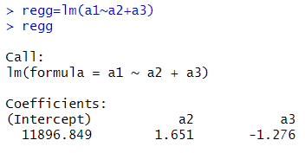
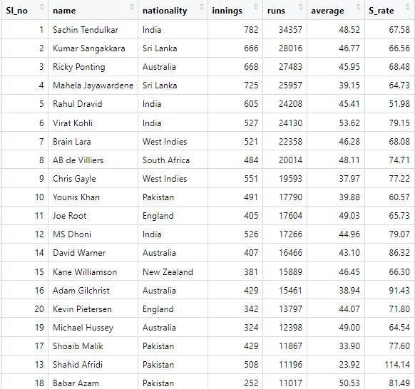
Multiple regression between the teams:
Rcode:
regg=lm(a1~a2+a3)
regg
Sorting of players in decreasing order of the runs scored by them
Rcode:
df_sorted =Bat[order(Bat$runs, decreasing = TRUE), ]
df_sorted

Slide 9


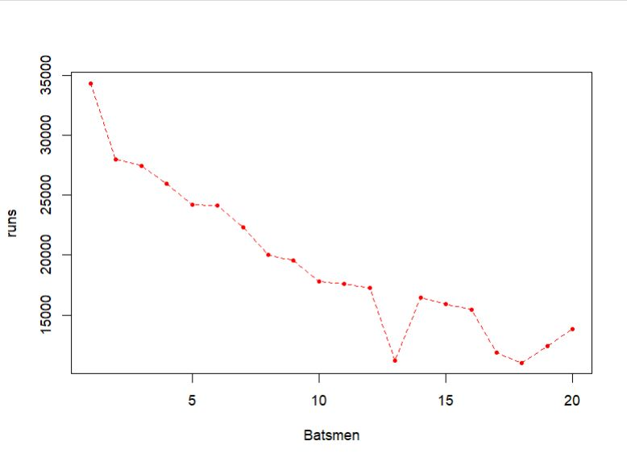
Highest average by a batsman
Rcode:
mu=which.max(Bat$average)
c1=Bat[mu,c("name","average")]
c1
Highest strike rate by a batsman
Rcode:
a1=mu=which.max(Bat$S_rate)
c2=Bat[mu,c("name","S_rate")]
c2
Plots
Rcode:
plot(runs,xlab = "Batsmen",type="o", pch=20,lty=2,col="red")

Slide 10
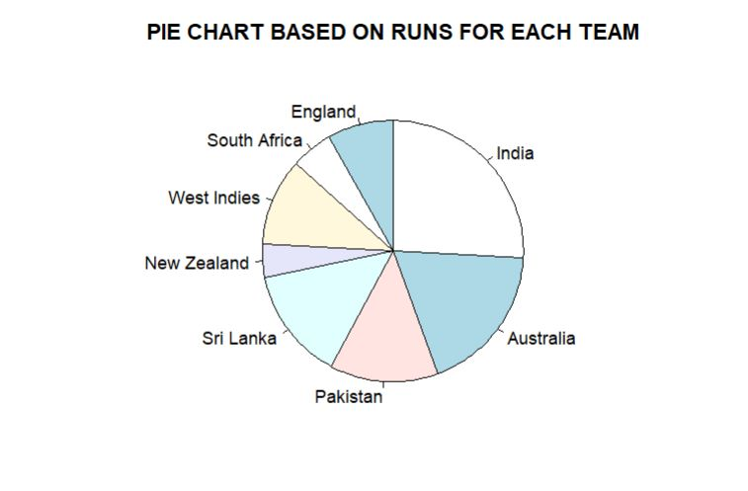
Rcode:
ind1=sum(Team_Ind$runs)
aust=sum(Team_Aus$runs)
paki=sum(Team_PAK$runs)
sri=sum(Team_SL$runs)
nz=sum(Team_NZ$runs)
wi=sum(Team_WI$runs)
sa=sum(Team_RSA$runs)
eng=sum(Team_Eng$runs)
x2=c(ind1,aust,paki,sri,nz,wi,sa,eng)
x3=c("India","Australia","Pakistan","Sri Lanka","New Zealand","West Indies","South Africa","England")
pie(x2,labels=x3,clockwise = TRUE,main = "PIE CHART BASED ON RUNS FOR EACH TEAM")

Slide 11
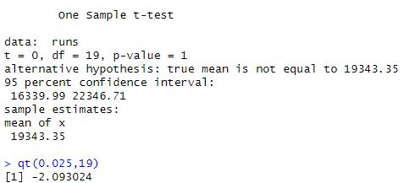
T-test
Case 1:
H0: The mean runs scored is 19343.35
H1: The mean runs scored is not 19343.35
Rcode:
t.test(runs,alternative="two.sided",mu=19343.35)
qt(0.025,19)
Conclusion: Since t(cal)<t(critical), reject null hypothesis at 5% LOS. Thus, the mean runs scored is 19343.35.

Slide 12
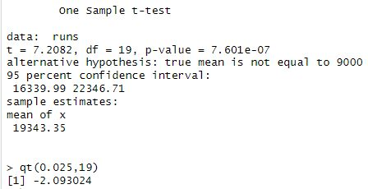
Case 2:
H0: The mean runs scored is 9000
H1: The mean runs scored is not 9000
Rcode:
t.test(runs,alternative="two.sided",mu=9000)
qt(0.025,19)
Conclusion: Since t(cal)>t(critical), reject null hypothesis at 5% LOS. Thus, the mean runs scored is not 9000.

